Slide 1


Magneto-electric Measurements and Driver Synthesis for Spintronic Equipments using Python
UGP presentation by Nikhil Jain, supervised by Dr. Arnab Bose, IIT Kanpur, Academic Year 2024–25
by Nikhil Jain

Slide 2
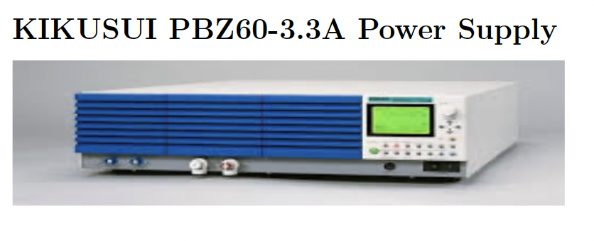
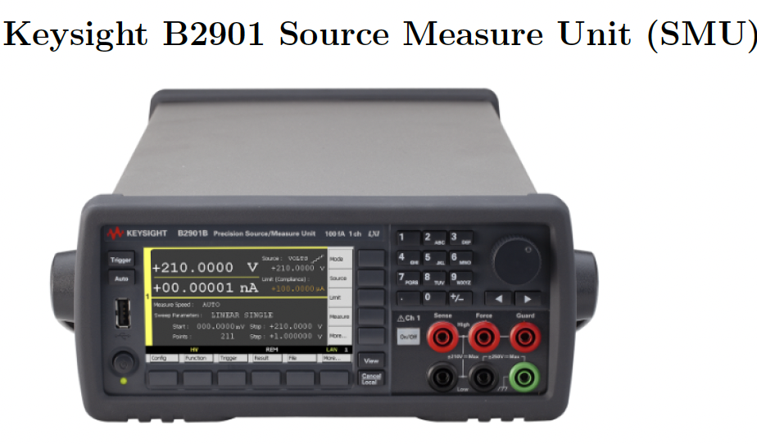
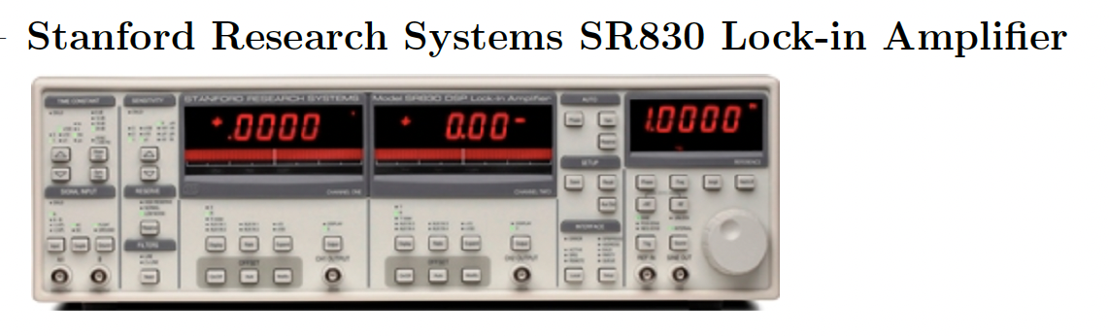
Abstract
Automation Goal
Automate magnetoelectric measurement processes efficiently
Devices Used
PBZ60 Power Supply
B2900 Source Measure Unit
SR830 Lock-in Amplifier
Achievements
Synchronized control and real-time data visualization
Applications
Supports magneto-transport studies for spintronic materials

Slide 3
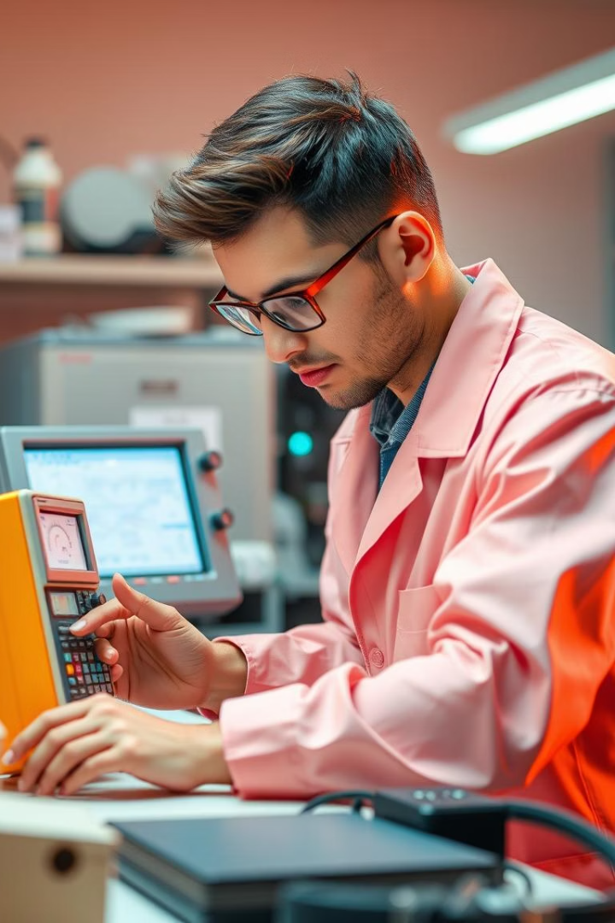
Introduction
Motivation
Challenge
Manual measurements are slow and prone to errors
Need scalable and reproducible experimental processes
Solution
Python-based automation for device control and data logging

Slide 4
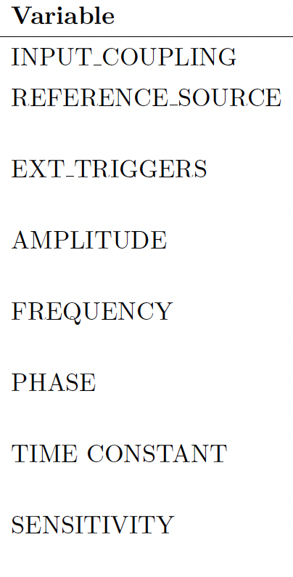
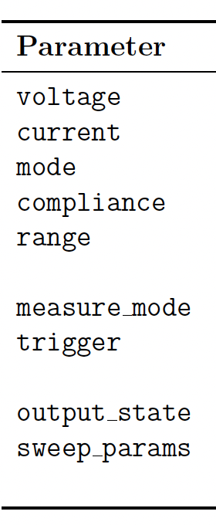
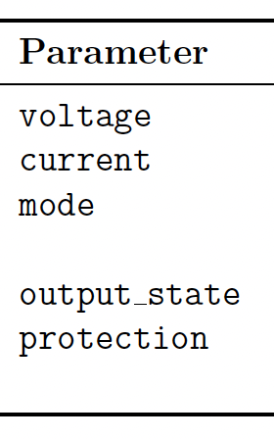
Devices, Driver Overview and Setup
PBZ60
B2900
SR830
Steps
Programmable current supply by Kikusui
Precision Source Measure Unit by Keysight
Lock-in Amplifier from Stanford Research Systems
Install dependencies (pyvisa, Keysight driver)
Python 3.9, pyvisa, instrument drivers,
GPIB-USB adapter
Organize files (sr830.py, pbz60.py, b2900.py)
Run scripts in main.ipynb (VS Code)

Slide 5
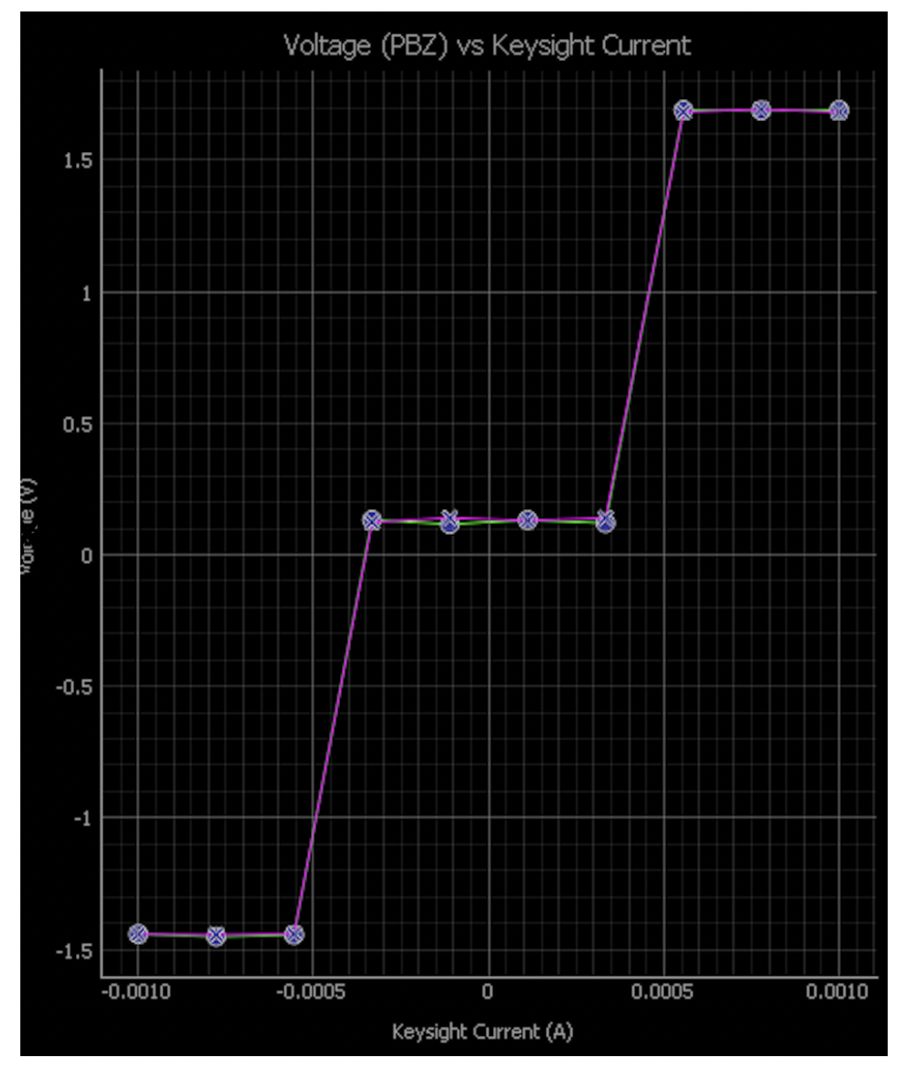
PBZ60 + B2900
Measurement System
B2900 Role
PBZ60 Role
Set constant current levels
Sweep current values continuously
Voltage Monitoring
Visualization
Measure output voltage response
Separate plots for forward and backward sweeps

Slide 6
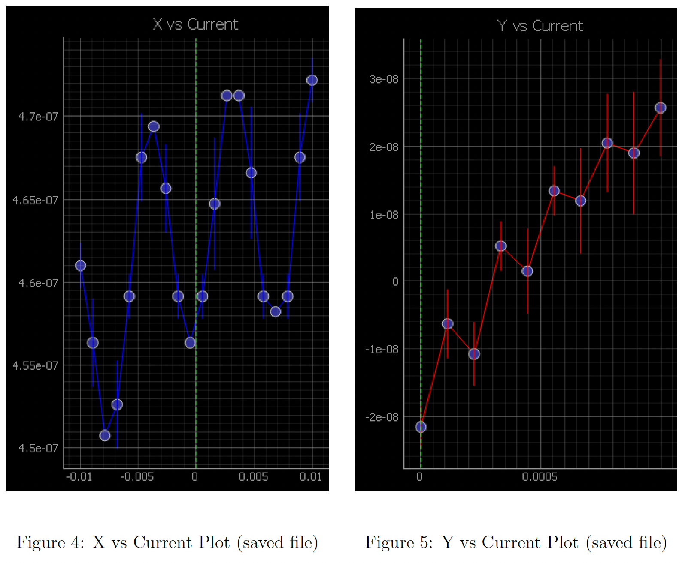




PBZ60 + SR830 Measurement System
Current Sweep
Control current via PBZ60
Voltage Measurement
SR830 records X and Y voltage channels
Real-Time Plotting
Live data visualization with error bars
GUI Features
Start, Stop, Save, Load operations

Slide 7
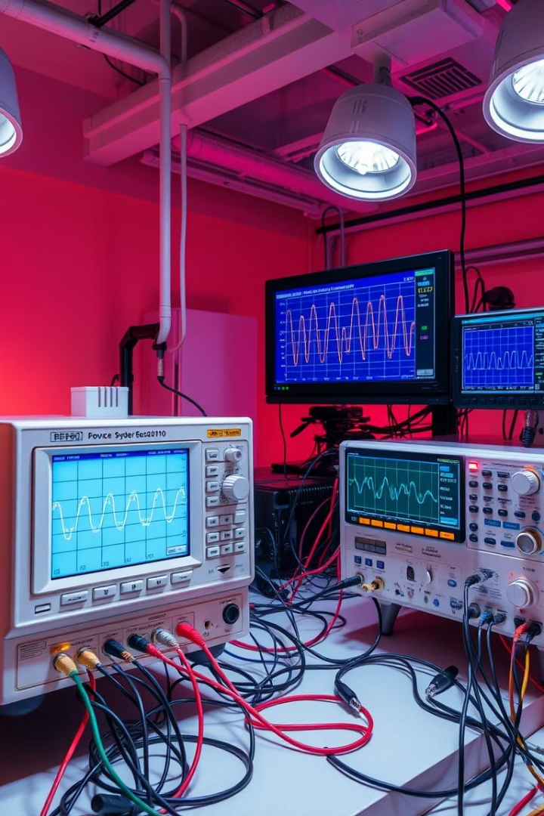
PBZ60 + B2900 + SR830 Nested Measurement
Outer Loop
Sweep B2900 current levels
Inner Loop
Sweep PBZ60 current values
Voltage Measurement
SR830 records complex voltage X and Y channels
Data Visualization
Separate plots per B2900 setting, forward and backward sweeps

Slide 8
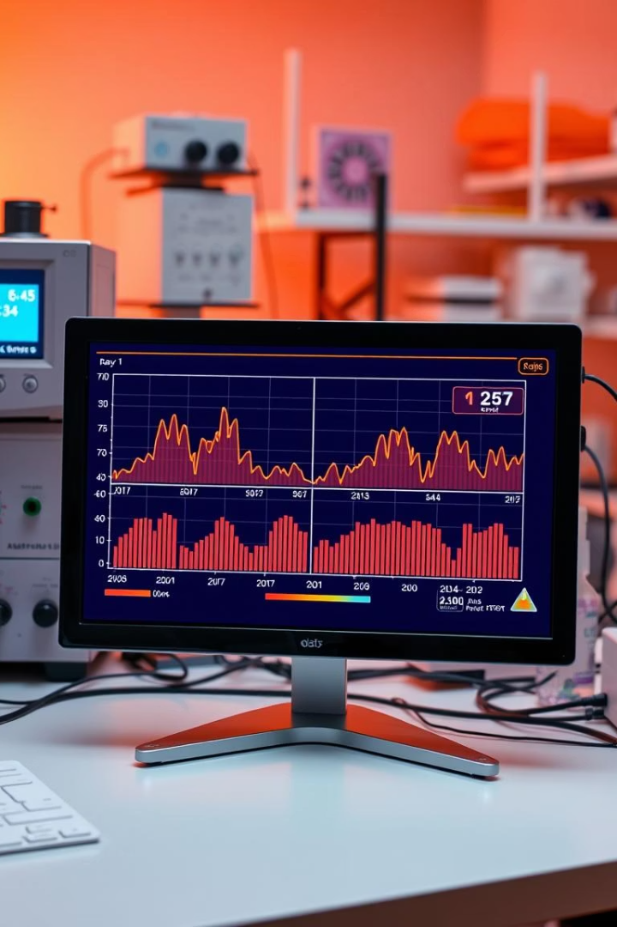
Results, Discussion, and Conclusion
Instrument Performance
No errors, reliable device responses
Data Quality
Real-time plots with standard deviation error bars
Automation Benefits
Improved speed, accuracy, and reproducibility
Python Impact
Robust control and scalable experiments

Slide 9
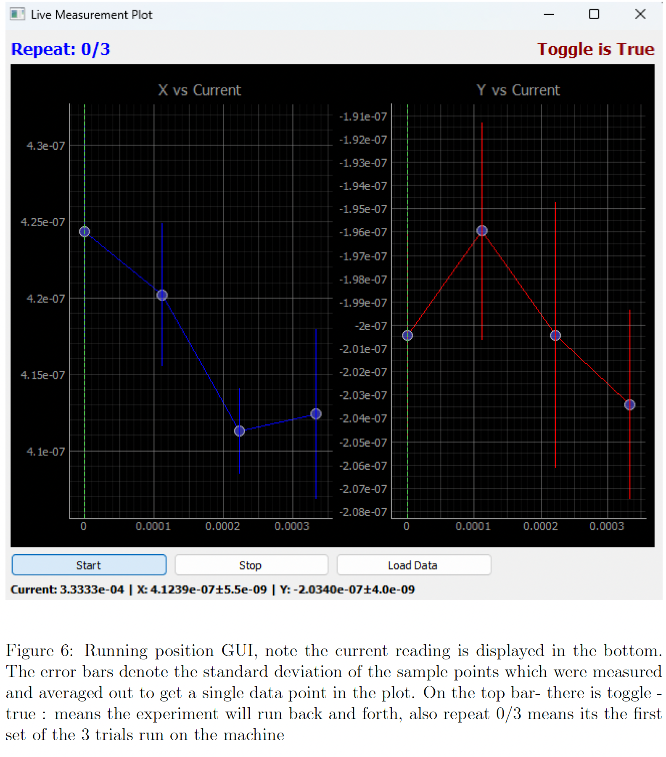

Slide 10
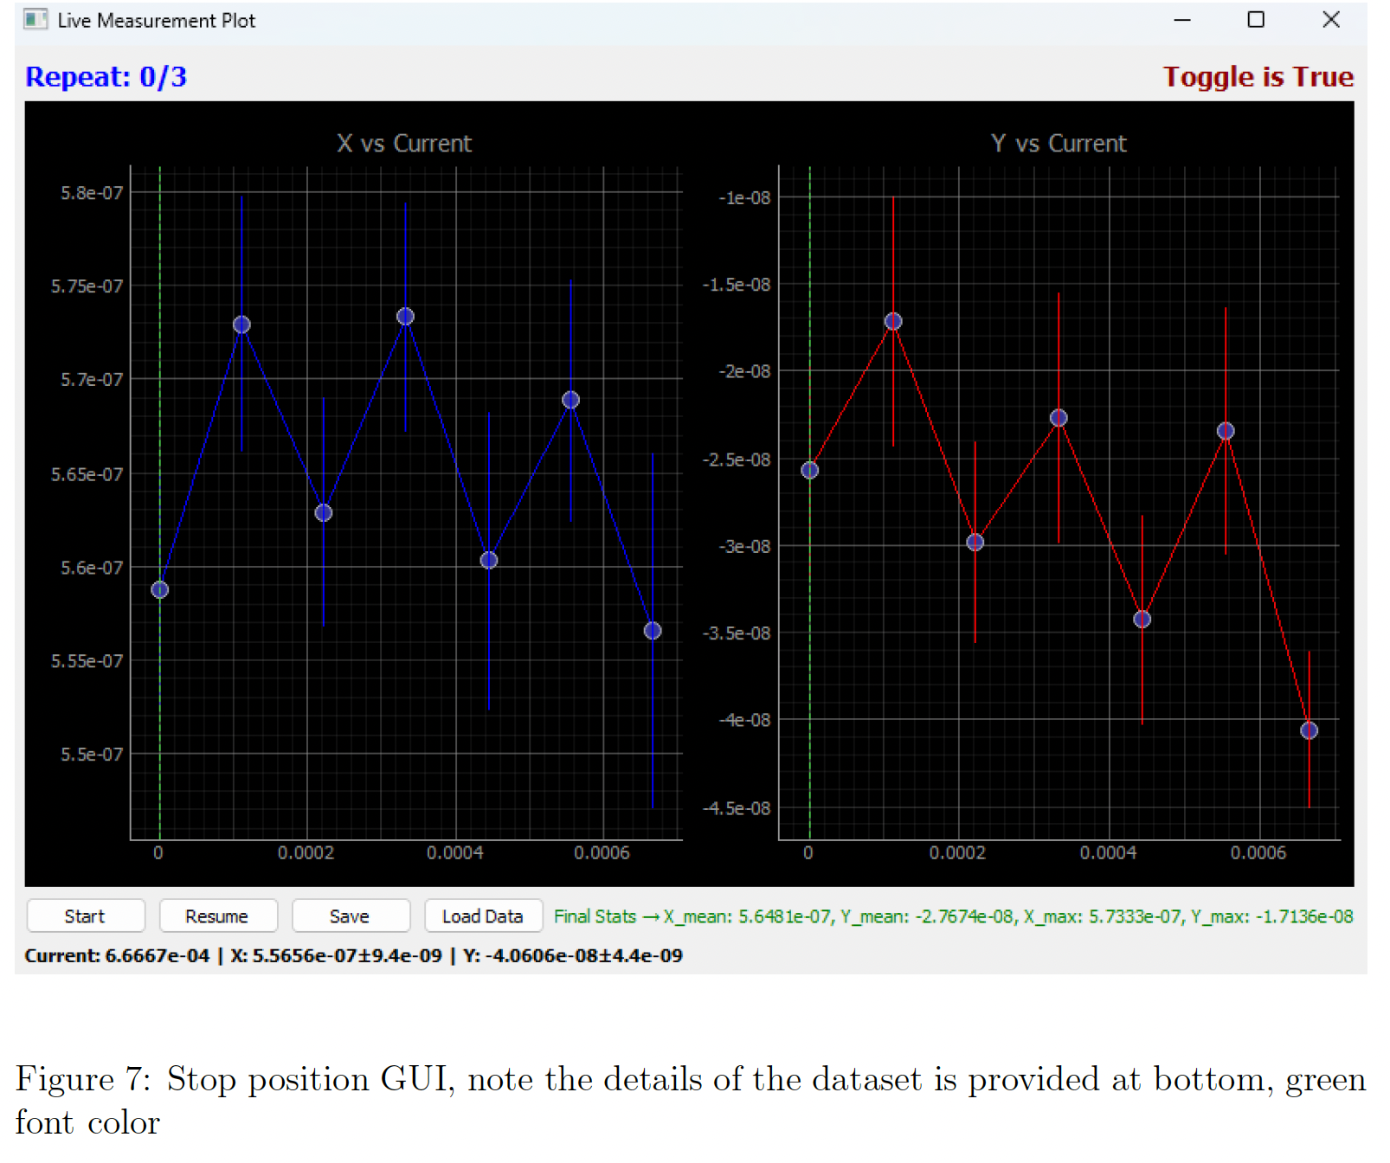

Slide 11
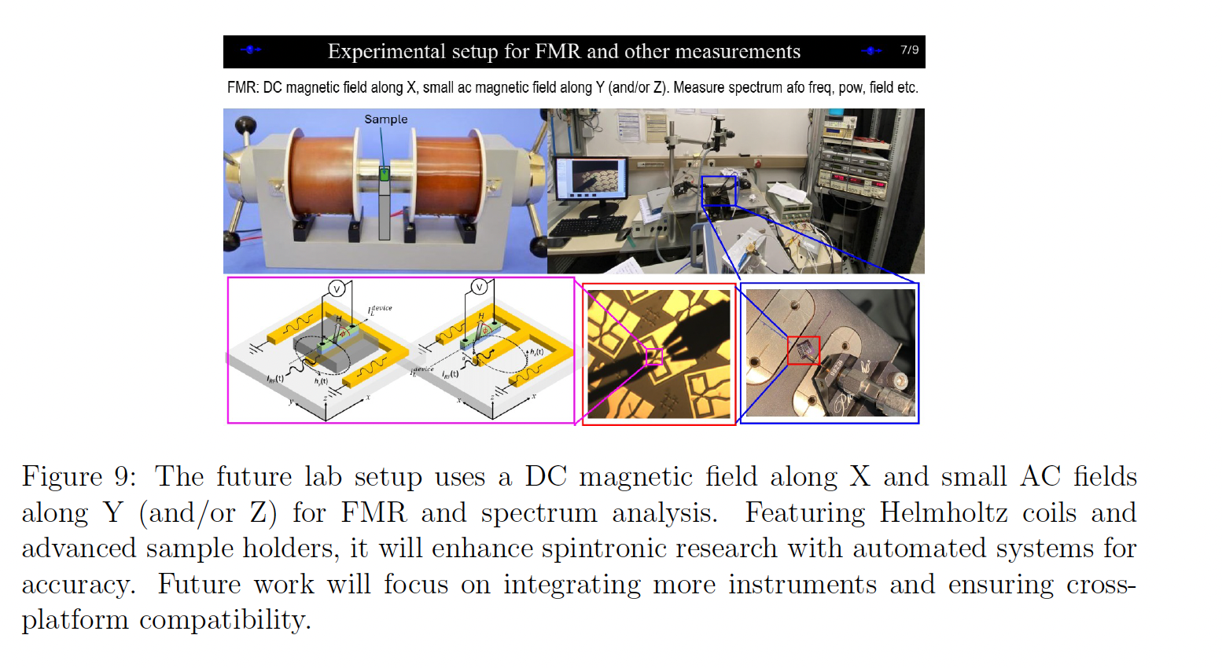
Future Prospects
Expansion Plans
Integrate DC and AC magnetic field experiments
using Helmholtz coils
Advanced Techniques
Include Ferromagnetic Resonance and spectral analysis
Software Improvements
Cross-platform device drivers, multi-instrument integration
Automation Focus
Enhance automation for next-gen spintronic research

Slide 12
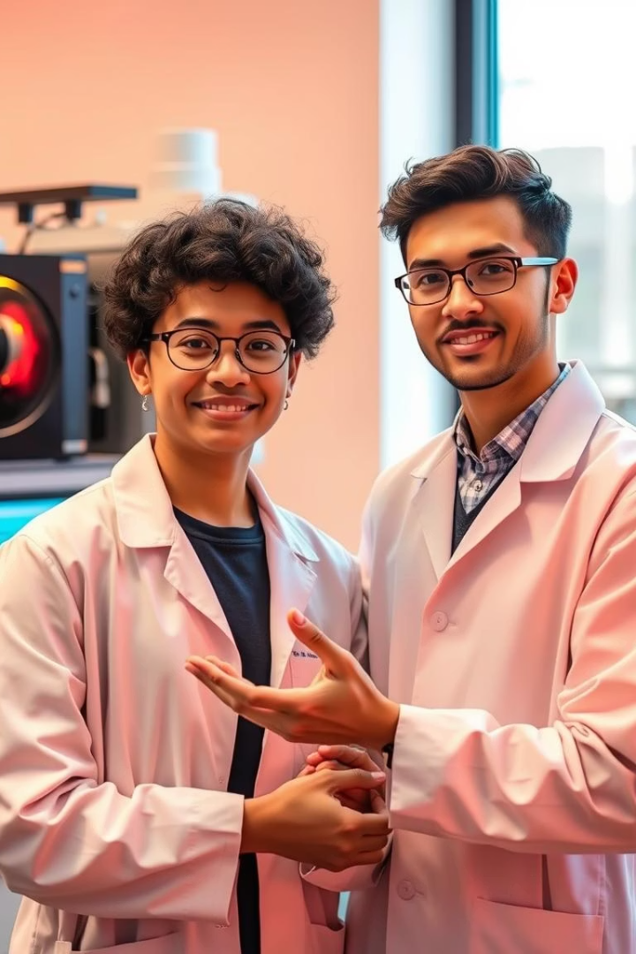
Thank you!
Acknowledgements
Dr. Arnab Bose
Nayani Om Swarup (230686)
Qcodes community

